Slide 2
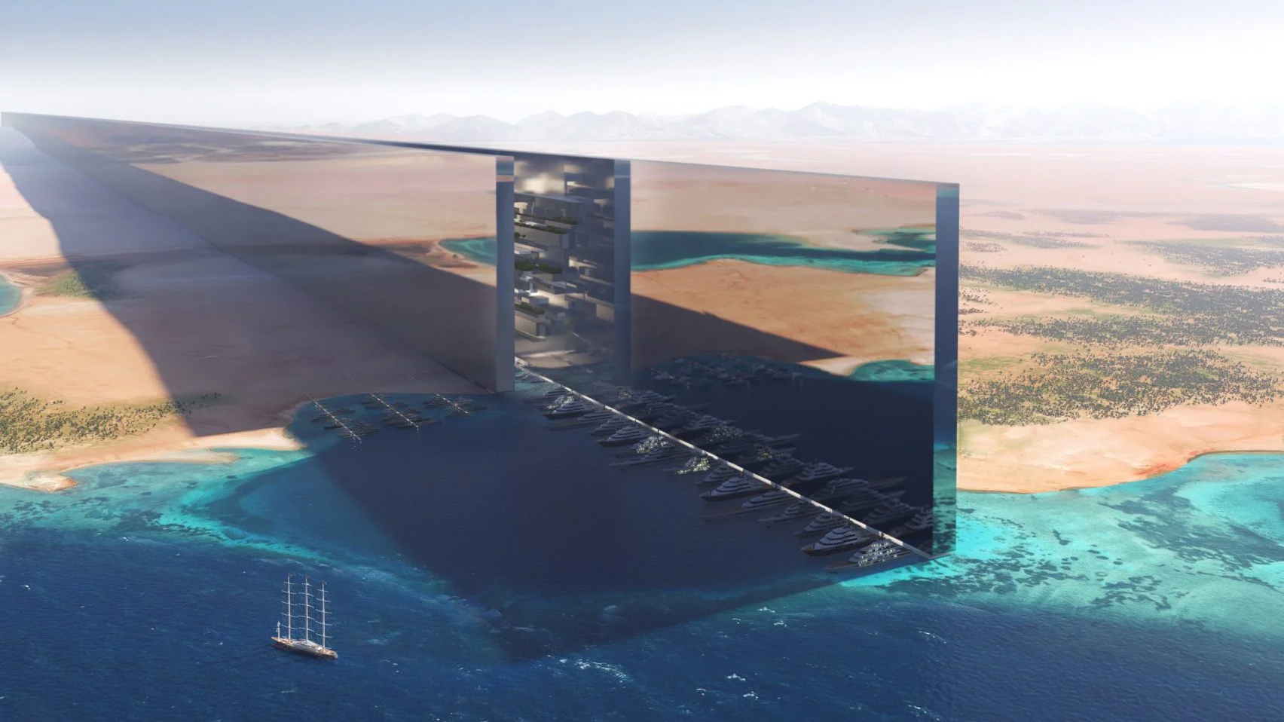
NEOM

Slide 3
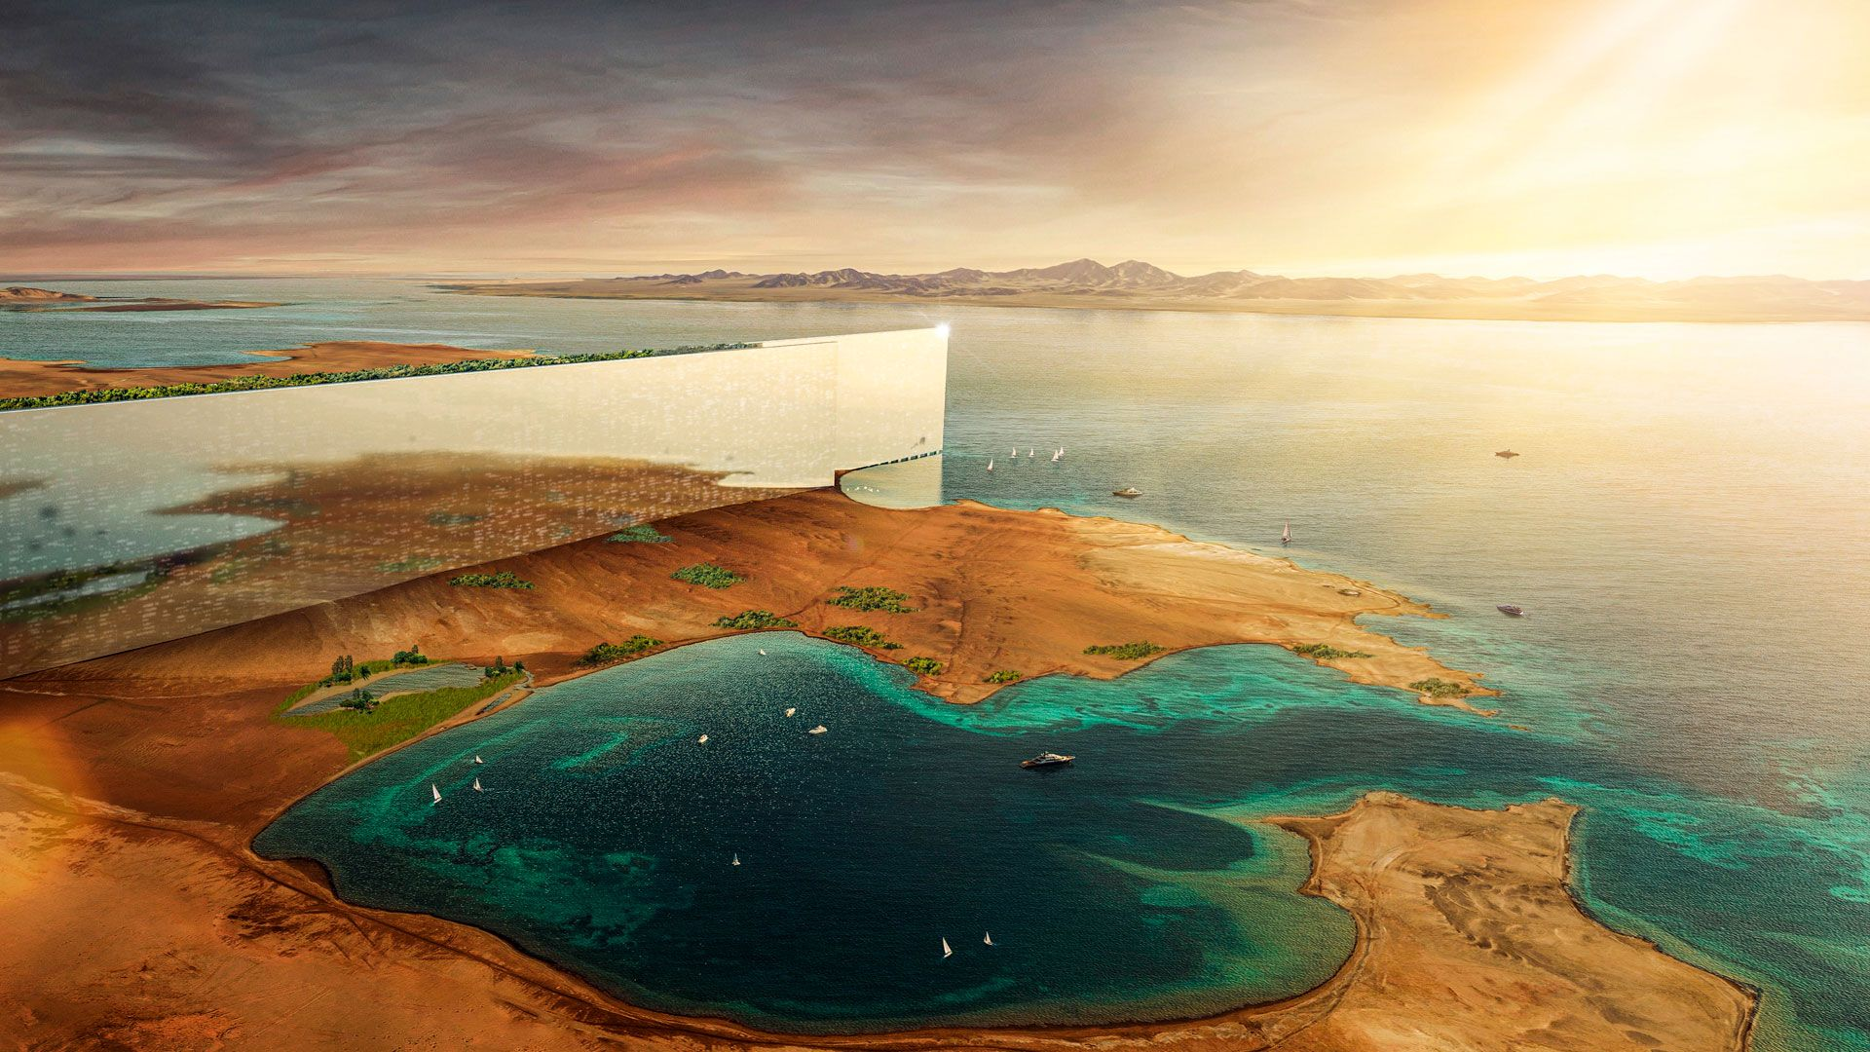
Introduction:
As it is known, for many years, humans were seeking to develop and progress to facilitate his life, so technology became active. But have you ever thought that one day humans will be able to combine technology and sustainable development?
There is a city under construction that secures peace for humans, animal and the environment, the NEOM city. . NEOM is the newest attempt in combining technology, entrepreneurship, science, and innovation to create a city with limitless opportunities.

Slide 4
Origin:
The name "NEOM" is derived from two words. The first three letters from the Ancient Greek prefix neo-meaning "new". The fourth letter is from the abbreviation of ‘Mostaqbal’, an Arabic word meaning "future".

Slide 5
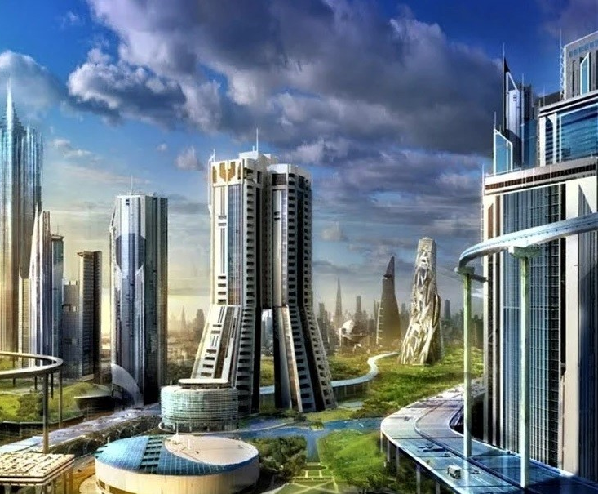
What is NEOM “the smart city”?
First unveiled by Mohammed bin Salman (the crown prince and minister of Saudi Arabia) in 2017, Neom is Saudi Arabia's flagship business and tourism development on the Red Sea coast. It is a central project in the 2030 Vision outlining the kingdom's plans to diversify the economy.
The $500 billion development will include smart towns and cities, ports and enterprise areas, research centers, sports and entertainment venues and tourist centers.

Slide 6
What is NEOM “the smart city”?
The development will be spread across 26,500 square kilometers and will comprise several zones, including industrial and logistics areas. It is planned for completion in 2030.
The plans include a network of airports, including an international one. The first, called Neom Bay Airport in the northern region of Sharma, opened in June 2019 and operates regular flights for Neom investors and employees.

Slide 7
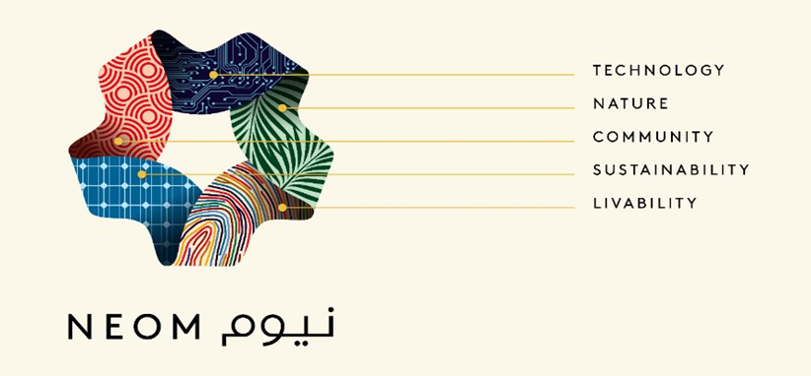

Slide 8
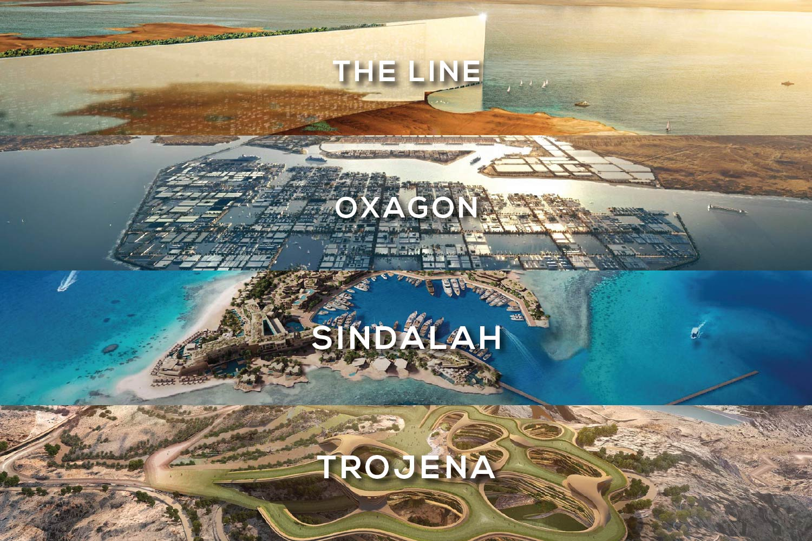
What will be in NEOM?
According to the developer (Nadhmi Al-Nasr), Neom will consist of 10 projects that they refer to as regions. So far, details of four of the regions have been announced. These are The Line, which is the most well-known, as well as Oxagon, Trojena and Sindalah.

Slide 9

The line
The Line is planned to be a 170-kilometre linear city that will house nine million people. It will run from east to west across the Neom region. According to the developer, the city will consist of two parallel, 500-metre-high, linear skyscrapers standing 200 meters apart. The buildings will be clad with mirrored facades.

Slide 10
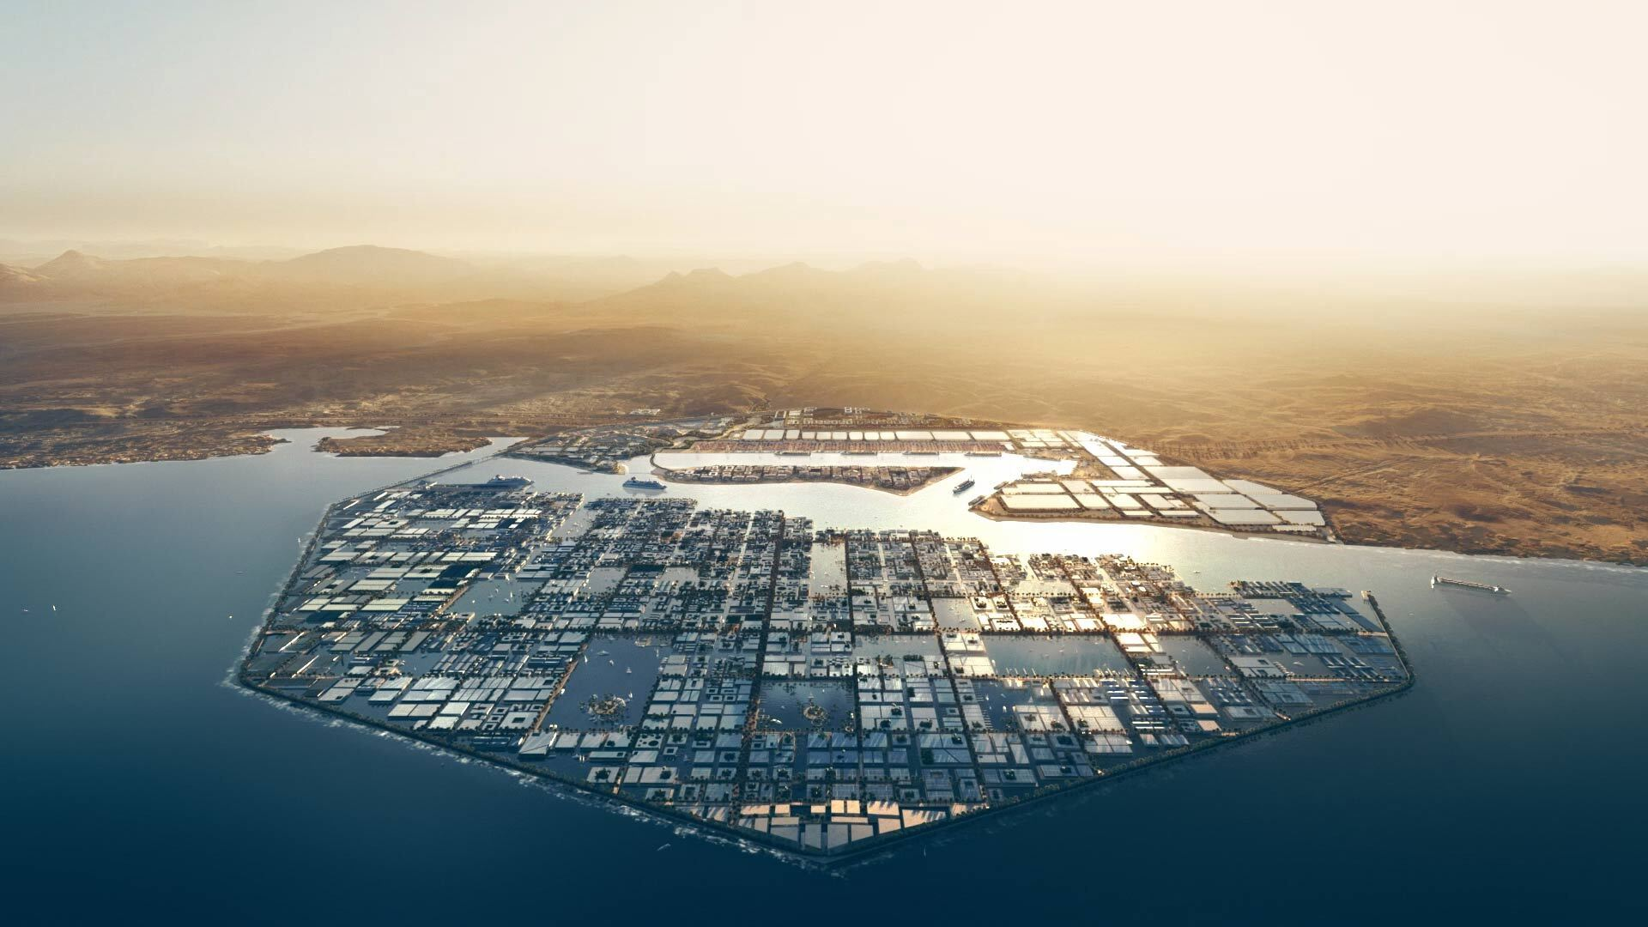
Oxagon
Oxagon is planned as an octagon-shaped port city that will be built on the Red Sea at the far south of the Neom region. According to Neom's developer, the port and logistics hub will be the "world's largest floating structure".
v

Slide 11
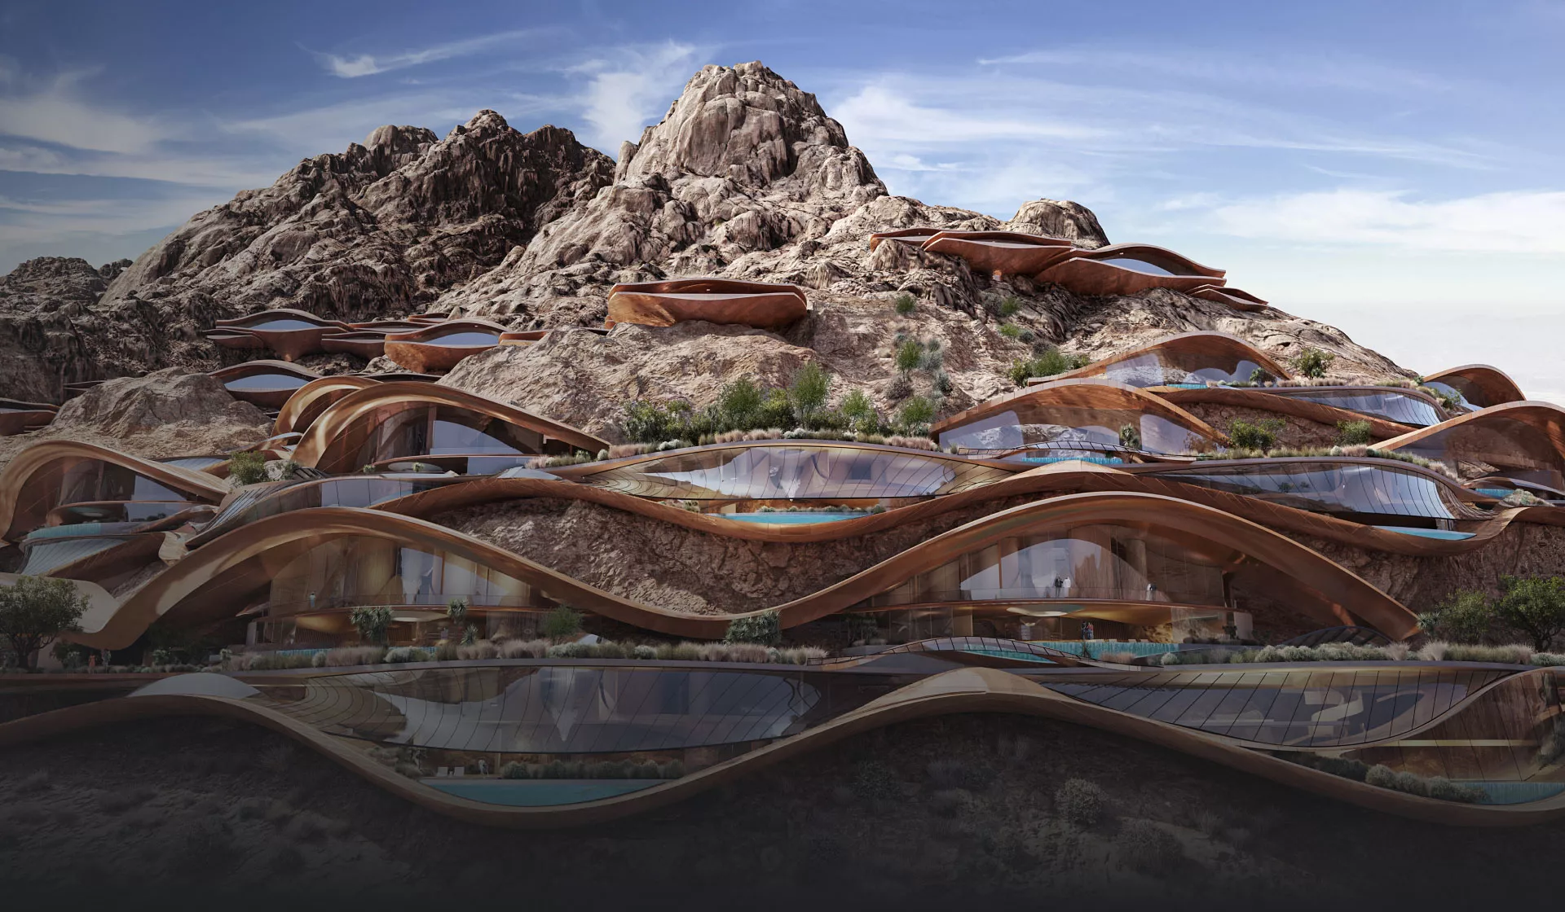
Trojena
Trojena is planned as ski resort in the Sarwat Mountains near the north of the Neom region. The 60-square-kilometre skiing and outdoor-activity resort will offer year-round skiing and is set to host the 2029 Asian Winter Games.
v
v
v

Slide 12
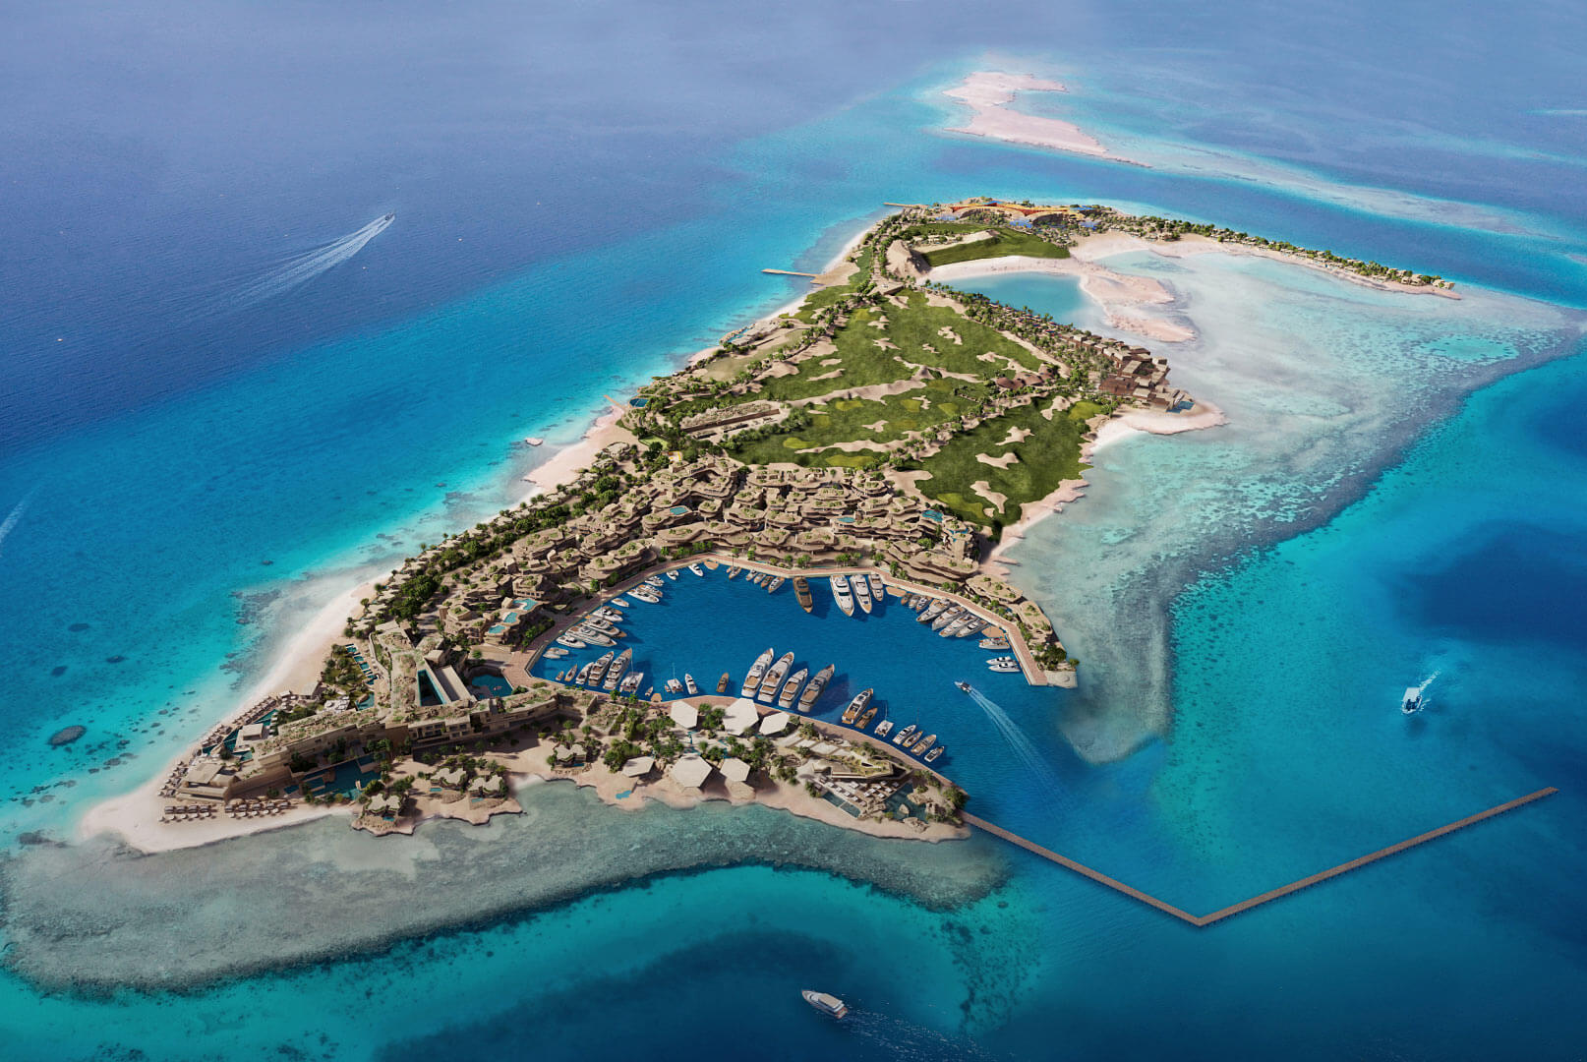
Sindalah
v
v
v
Sindalah is planned as an island resort within the Red Sea. Aimed at the yachting community, the 840,000-square-metre island will have an 86-berth marina and numerous hotels.

Slide 13
What’s so special about the Line?
The Line will be the first city in the world to be powered by renewable energy including wind, solar and hydrogen. The Line will also be the world's first zero-gravity vertical city.(it is touted to be zero cars, zero pollution and zero carbon emissions). There will be a hyper rail line running through the city to boost travel. This rail line will be powered through a renewable-powered electric system.
v
v
v

Slide 14
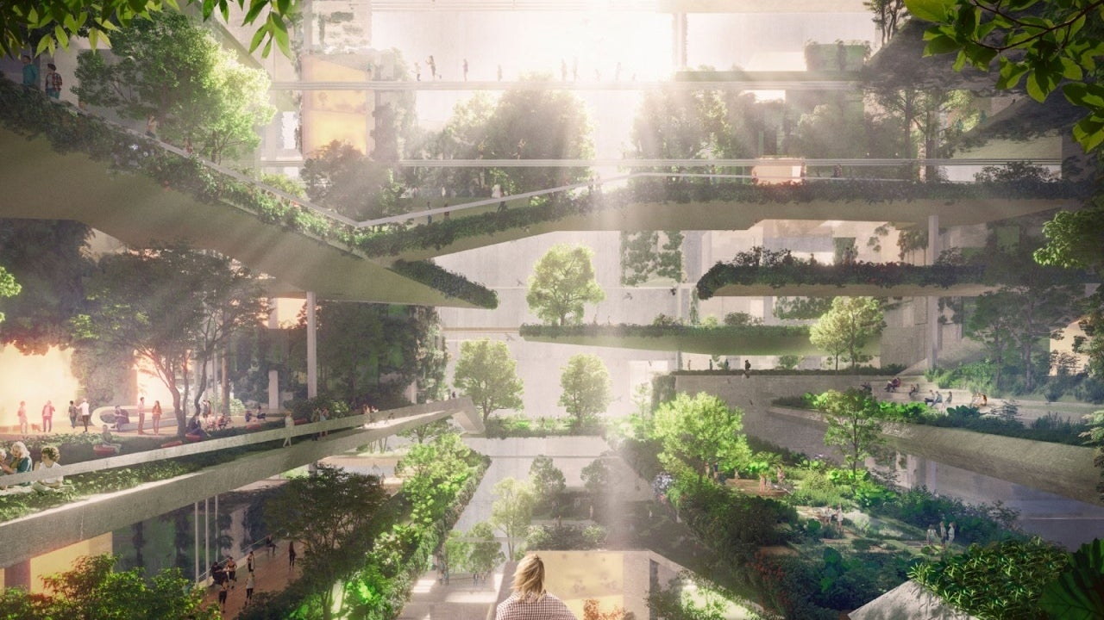
What’s so special about NEOM?
Neom is designed to respond to some of the most pressing global challenges facing urban areas and inspire an alternative way of living.
The city will preserve 95 per cent of the natural environment around the site, highlighting mankind's relationship with the natural world.
All energy in Neom will be 100 per cent renewable ensuring a zero-emission, carbon-positive ecosystem.

Slide 15
What’s so special about NEOM?
Neom's water distribution network will be completely connected through advanced infrastructure. This will ensure minimal water loss, putting Neom at the forefront of water technology.
Walkability will define life in the city, with all essential daily services, such as schools, medical clinics, leisure centers and green spaces, within a five-minute walk.
High-speed transit will be among the ways residents will be able to travel longer distances, making all areas of Neom accessible within 20 minutes. An urban environment that prioritizes walking, cycling and personal electric mobility devices will be enhanced by access to high-speed public transit services connecting all neighborhoods.

